Slide 1

DATA SCIENCE JOBS AND SALARIES ANALYSIS
Solomon OKORO
github.com/soulsuv/data-science-jobs-and-salaries-analysis

Slide 2

OBJECTIVES
Analyse job market data from 2020 - 2023 to uncover global salary trends and job title remunerations in the data sector.
Create diverse charts to visually represent the analytical findings and insights.
Interpret chart data to highlight business implications, aiding recruiters in understanding job requirements and salary expectations.

Slide 3

DATA SUMMARY
Dataset has 9355 rows and 12 columns.
Work Year: Indicates the year of data collection, essential for analysing salary trends over time.
Job Title & Category: Specifies the role and its broader category, crucial for salary distribution analysis across specialties.
Salary Details: Includes gross annual salary in local currency and USD, enabling regional and global salary comparisons.
Employee Details: Covers the employee's residence and experience level, highlighting geographical and experience-related salary variations.
Employment Context: Encompasses employment type and work setting, reflecting their impact on salary structures.
Company Insights: Provides the company's location and size, analysing their influence on salary levels.

Slide 4
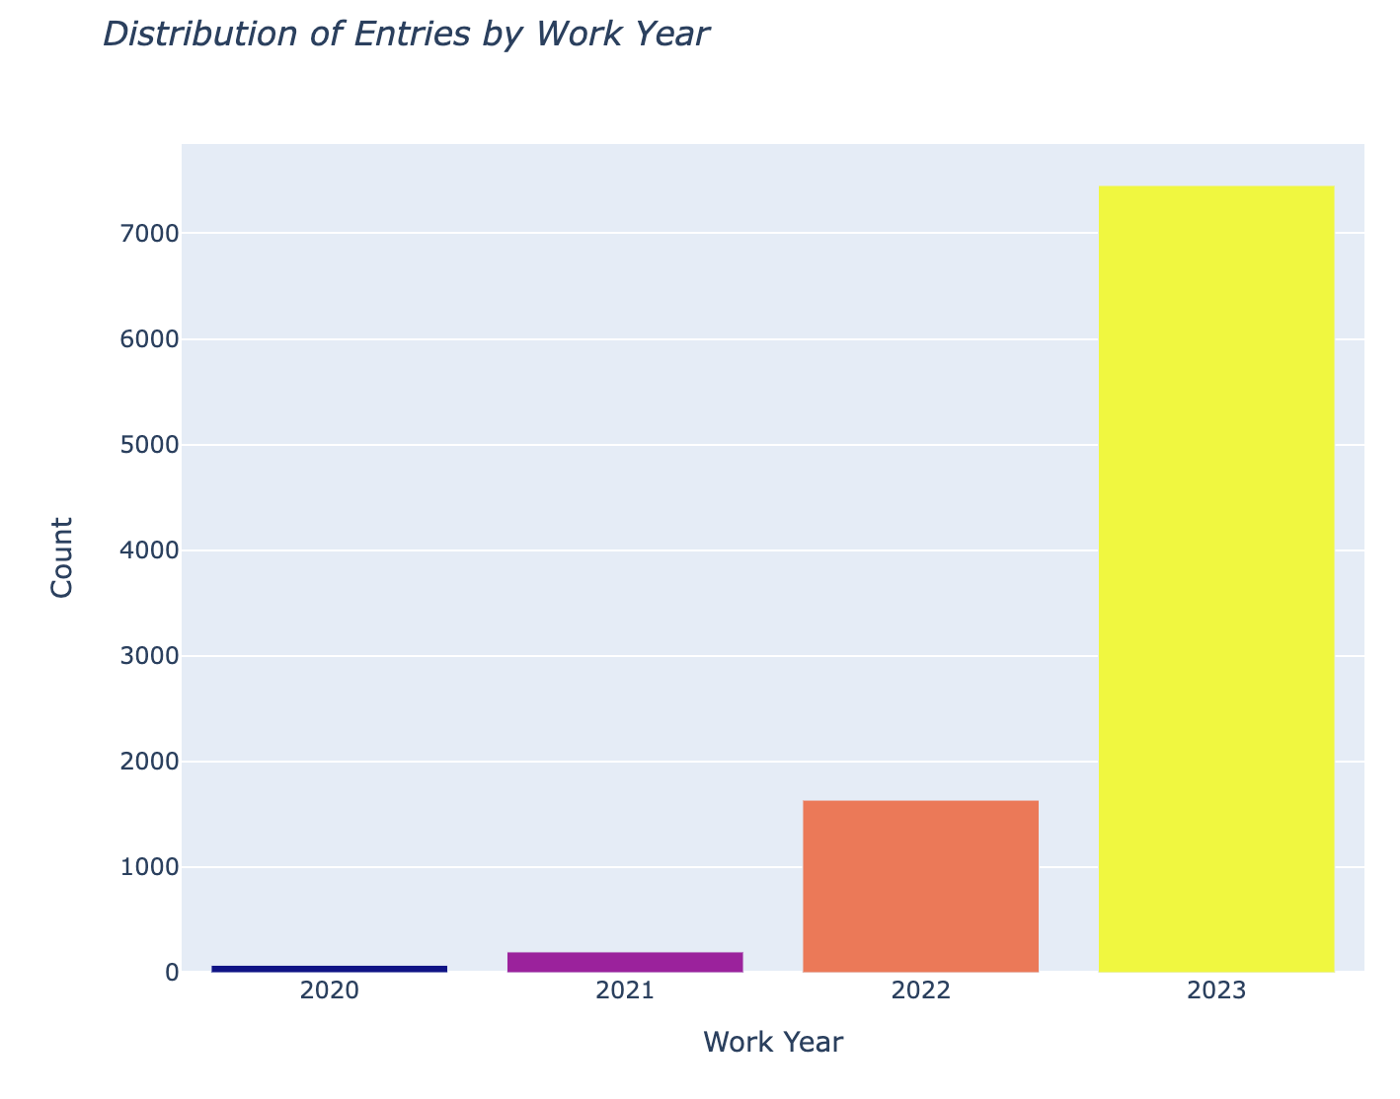
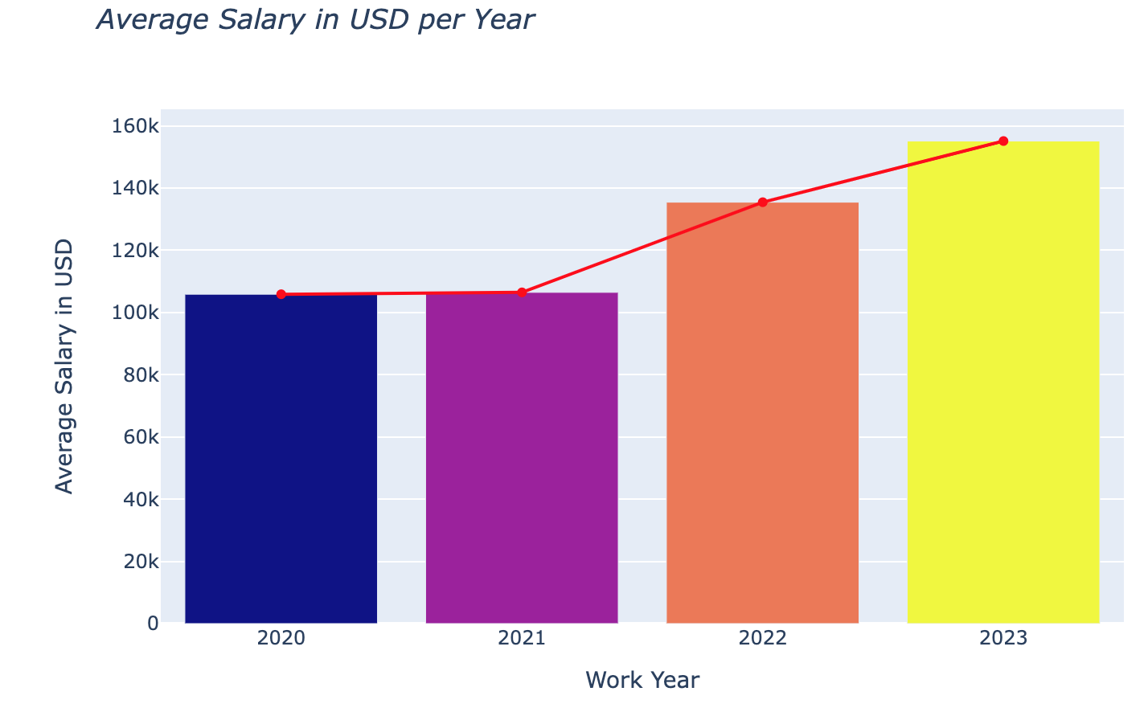
Growth of Data Roles & Average Salaries from 2020 - 2023
Exponential growth observed in the number of Data related jobs since 2020.
Average Salary for Data related jobs have also been on the increase since 2020.

Slide 5
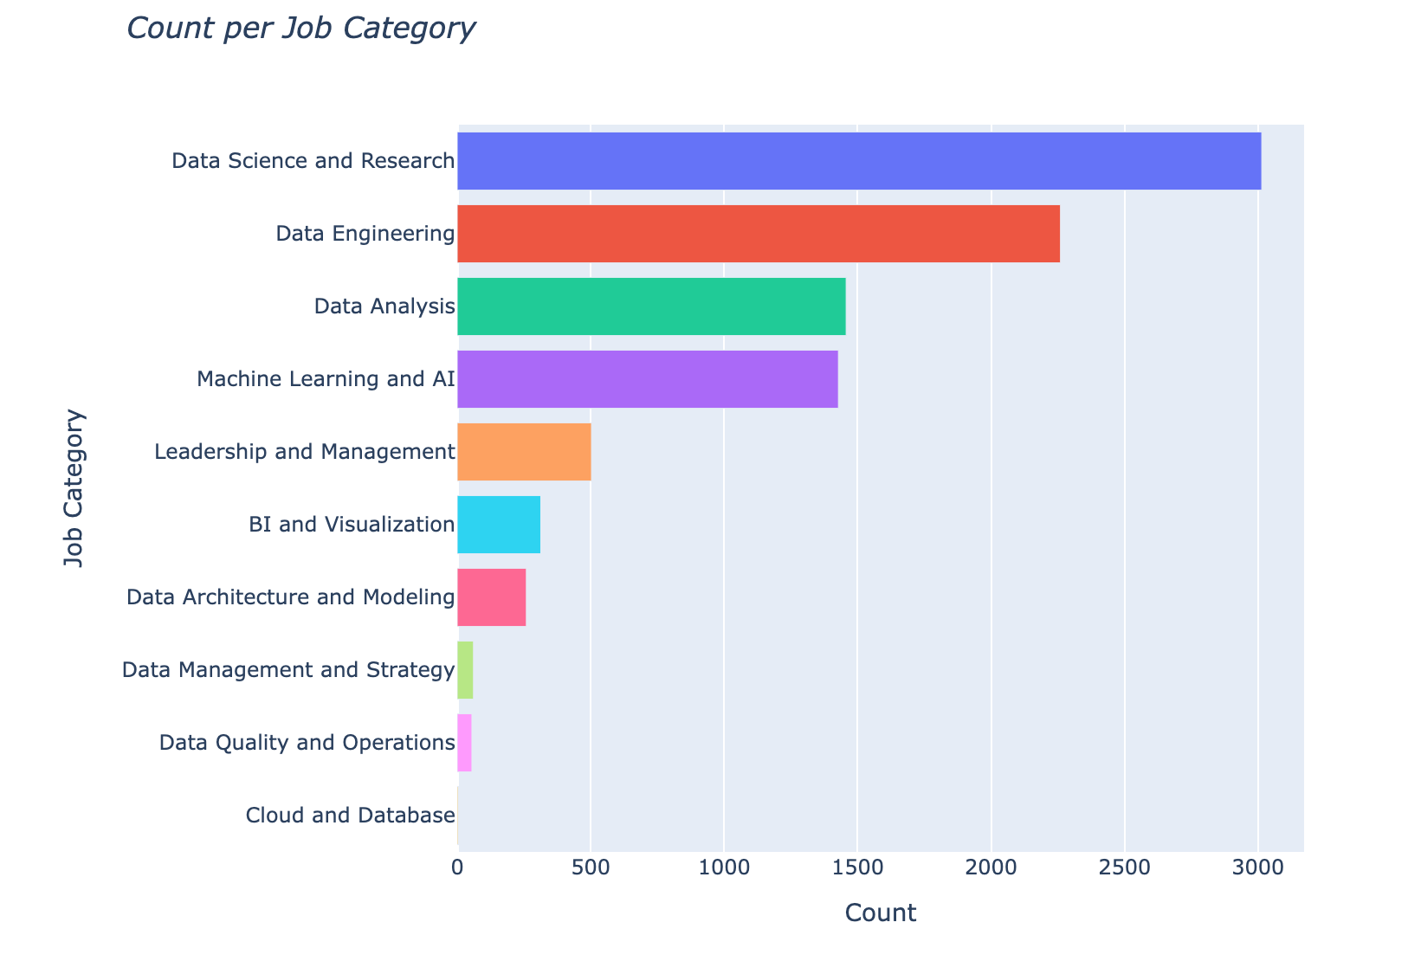
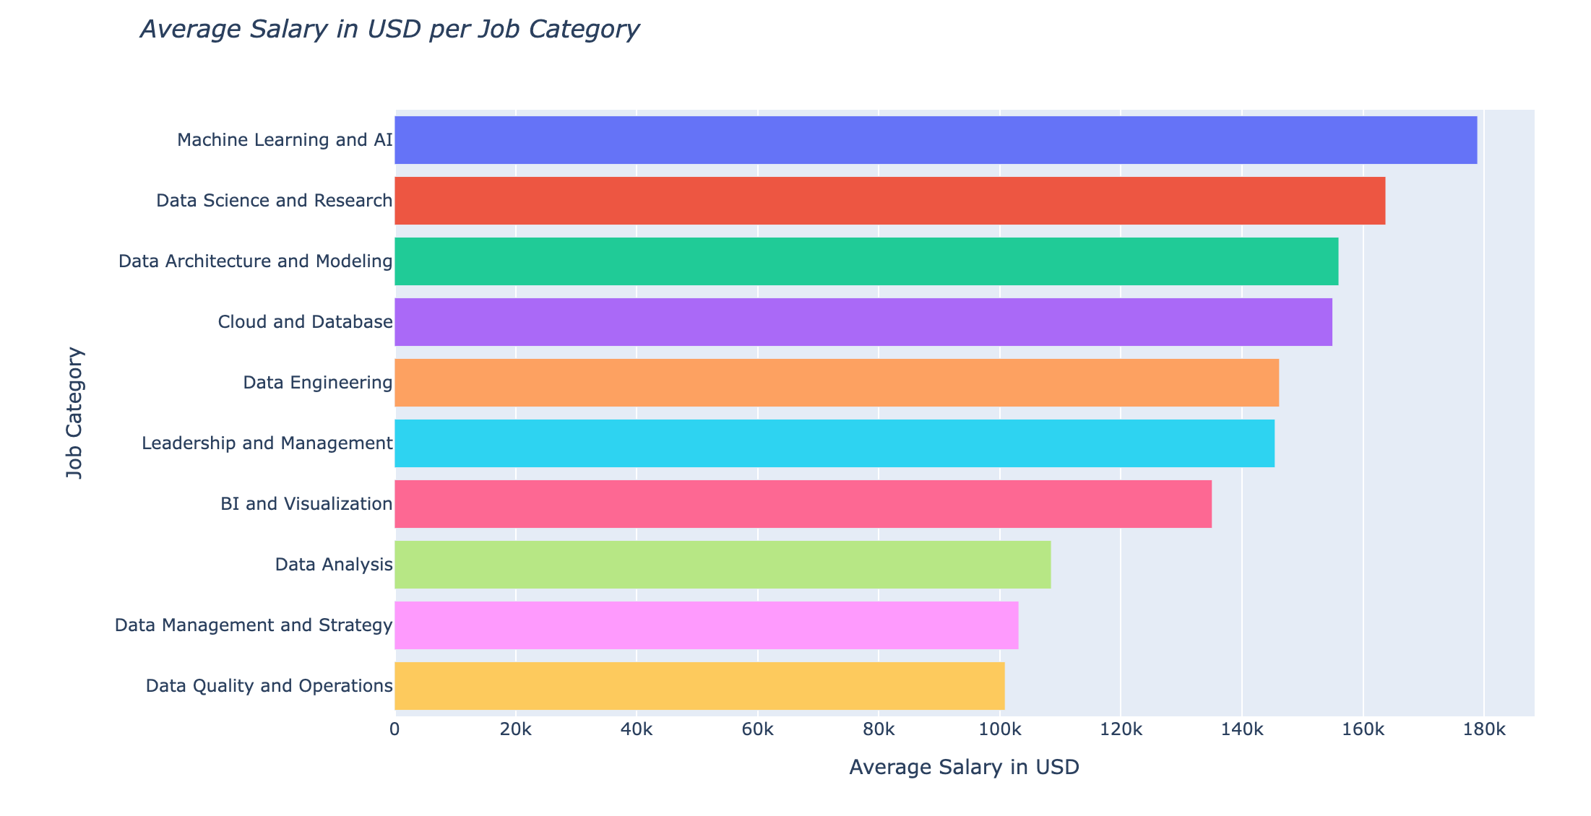
Distribution of Job Categories & Respective Average Salaries
Data Science and Research, Data Engineering and Data Analysis are the top three (3) job categories in the field.
Top three (3) Job Categories with highest average salary are Machine Learning and AI, Data Science and Research and Data Architecture and Modelling.
Data Analysis falls under the bottom three (3) paying category despite its prominence.

Slide 6
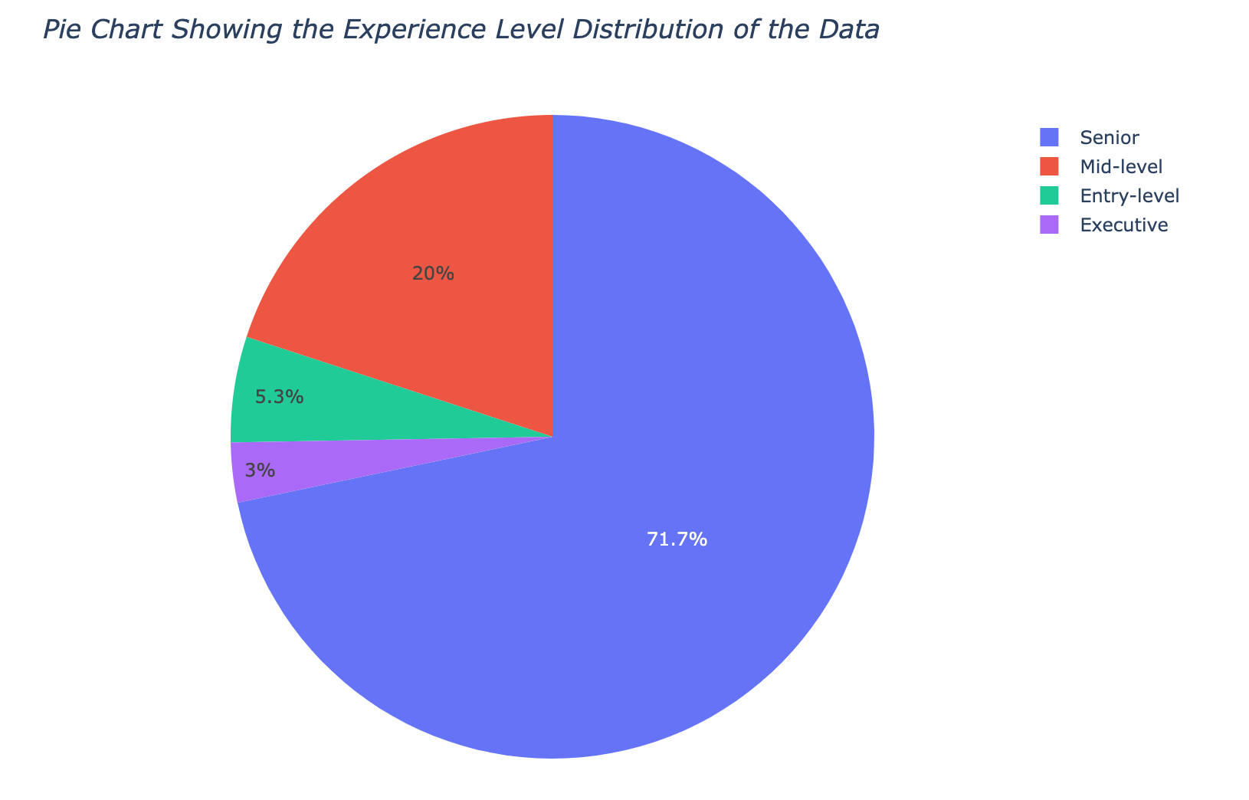
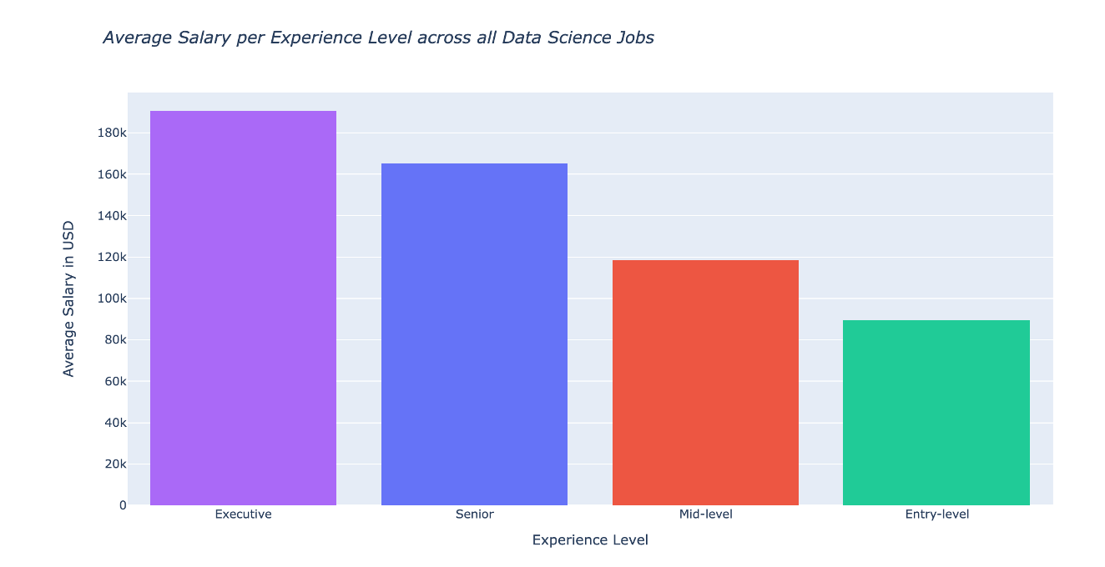
Distribution of Experience Level & Respective Average Salaries
Most dominant is Senior Level roles and least is for Executive roles.
As is expected, the average salary increases as the experience level increases.

Slide 7
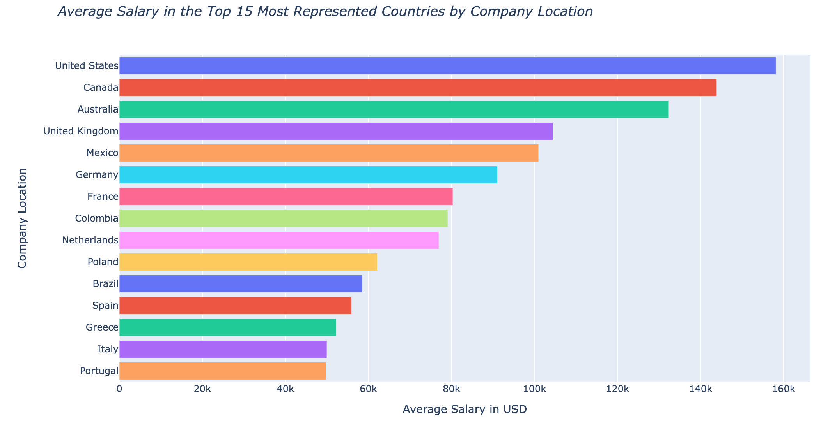
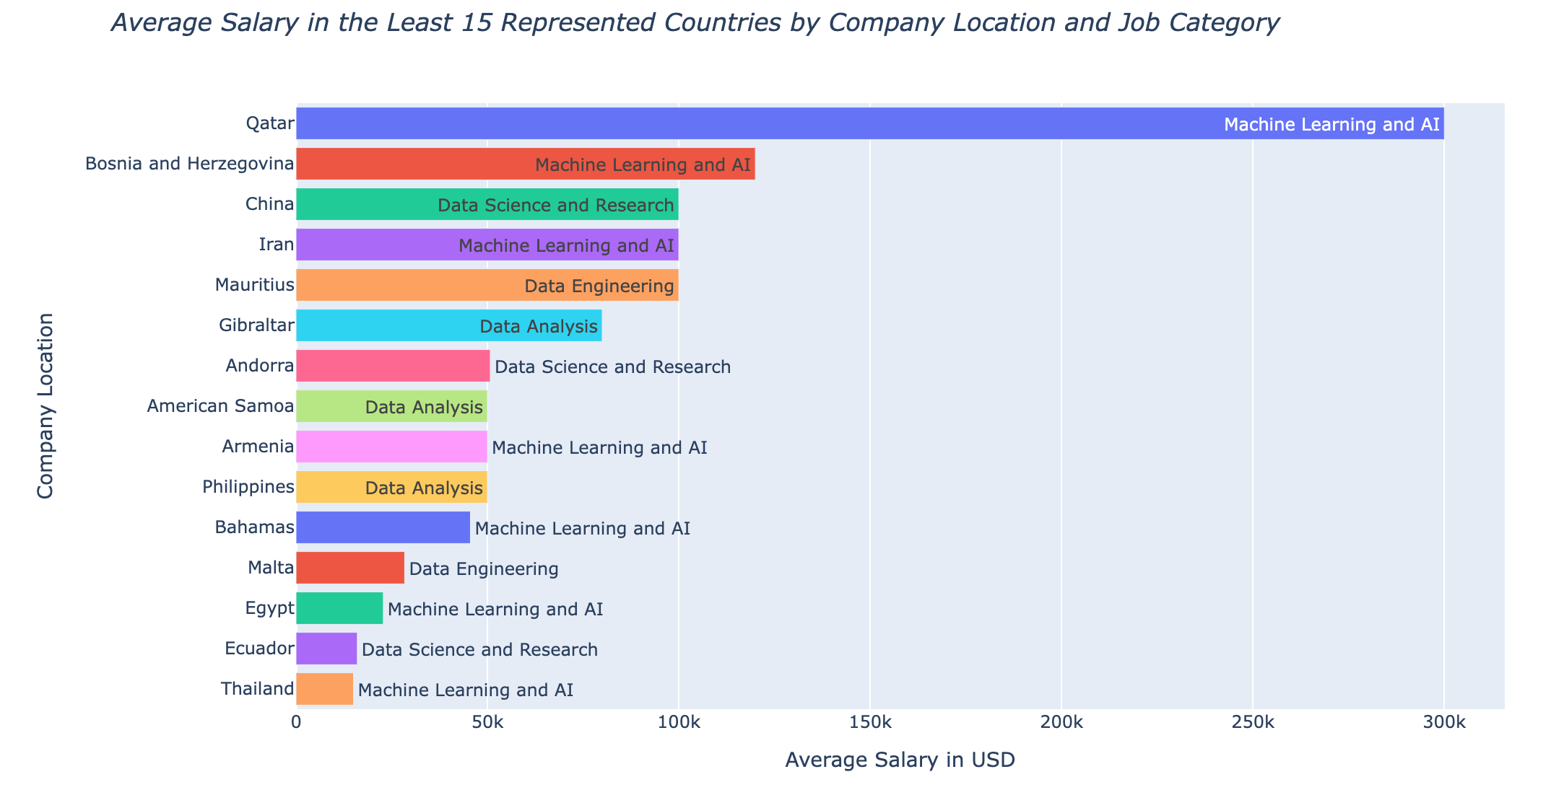
Average Salaries by Company Location (Top and Bottom 15)
Highest average salary for a Data Science role is in the United States. Top 15 paying Countries are in North and South America and Europe.
Bottom 15 average salaries are mostly in Asia and Africa. Exception is in Qatar as there was only a single job posted in Machine Learning and AI with a high pay of 300K USD.

Slide 8
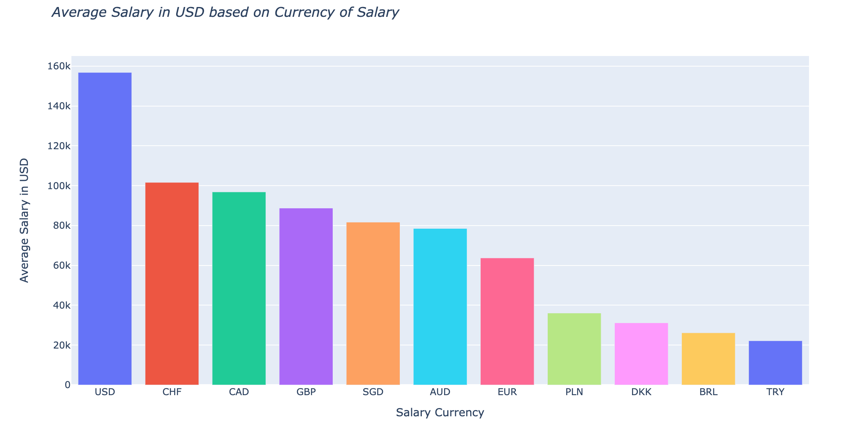
Average Salaries by Currency of Pay
Top Salaries are earned in USD, and least salary is earned in Turkish Lira (TRY).

Slide 9
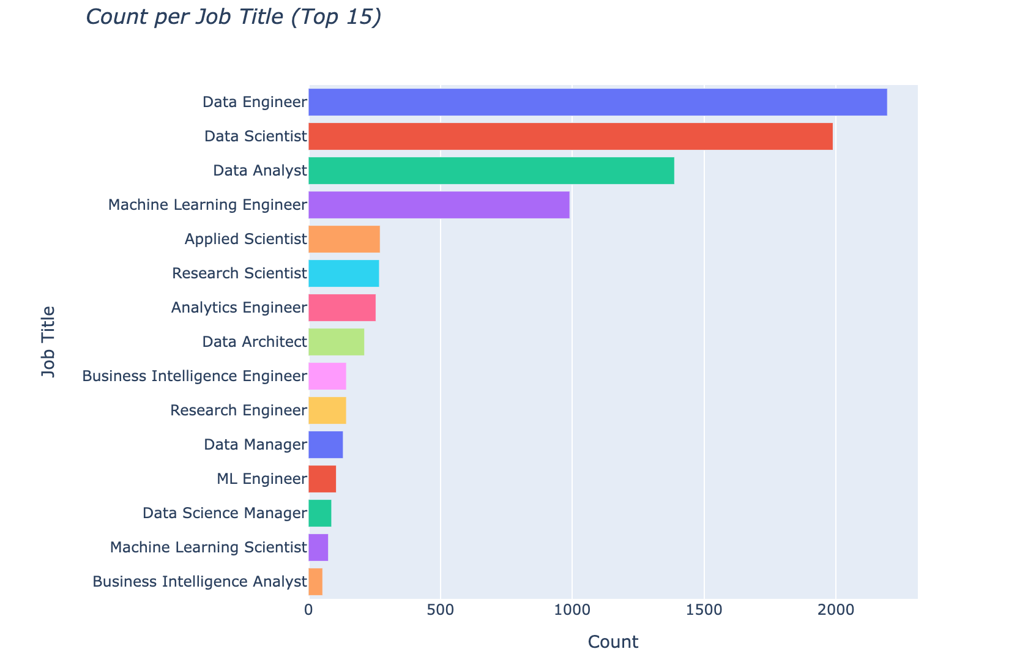
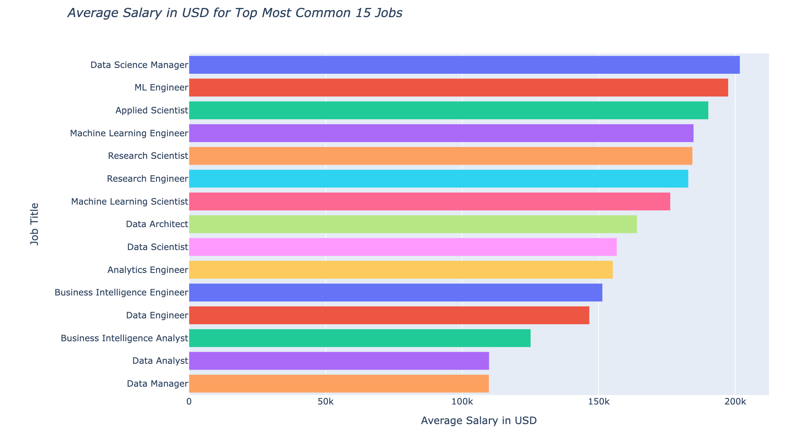
Distribution of Job Title & Respective Average Salary (15 Most Common)
125 Job Titles in the Data, summary shown for most common 15.
Generally, it appears that the more niche a Job Title is, the more the average salary for the Job Title.

Slide 10
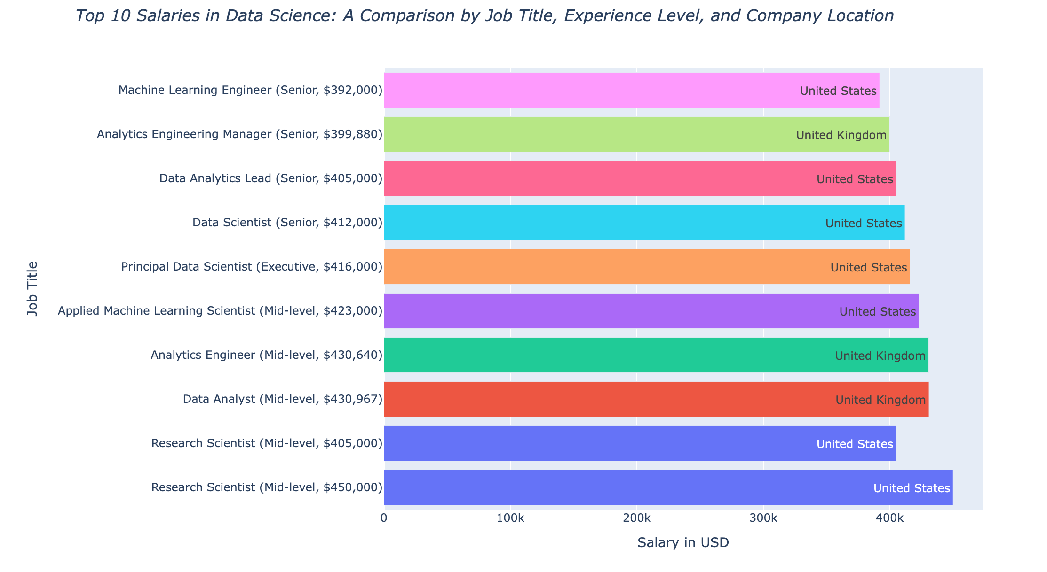
Top 10 Salaries Earned by Job Title, Experience Level and Location
The top Salaries are earned from Companies in the USA (70%) and the United Kingdom (30%). The Experience Level for these jobs are from Mid to Executive Level.

Slide 11
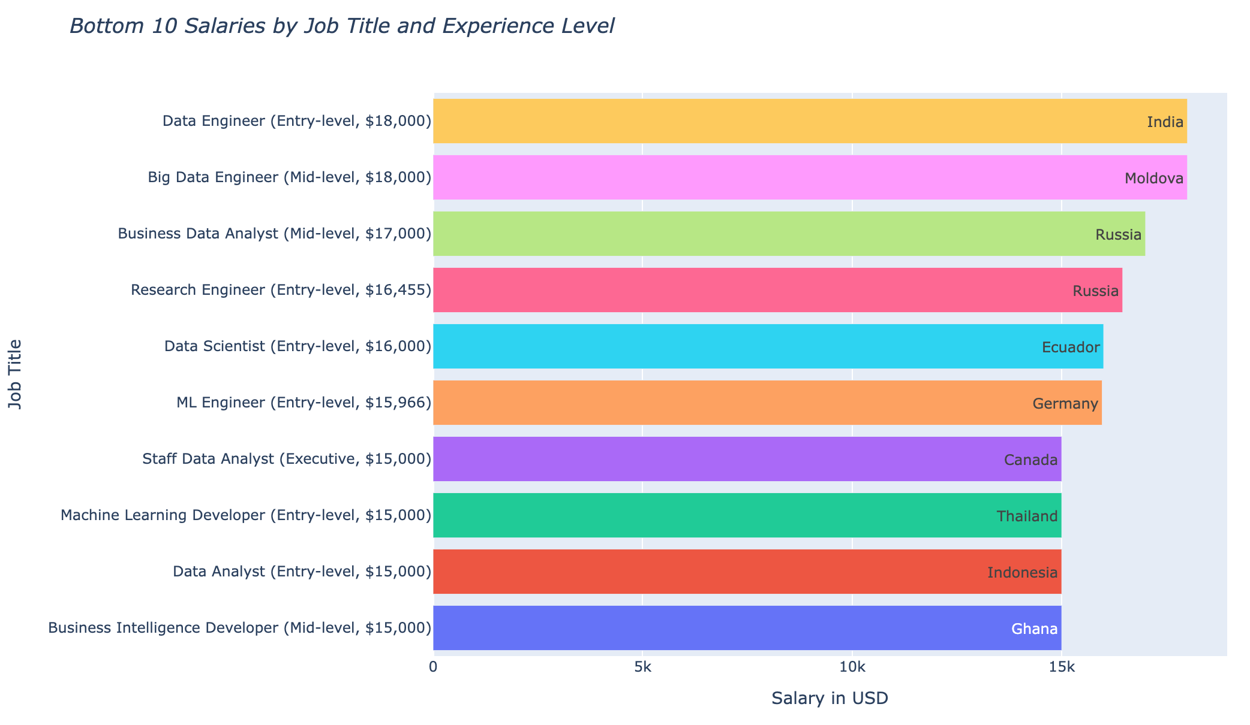
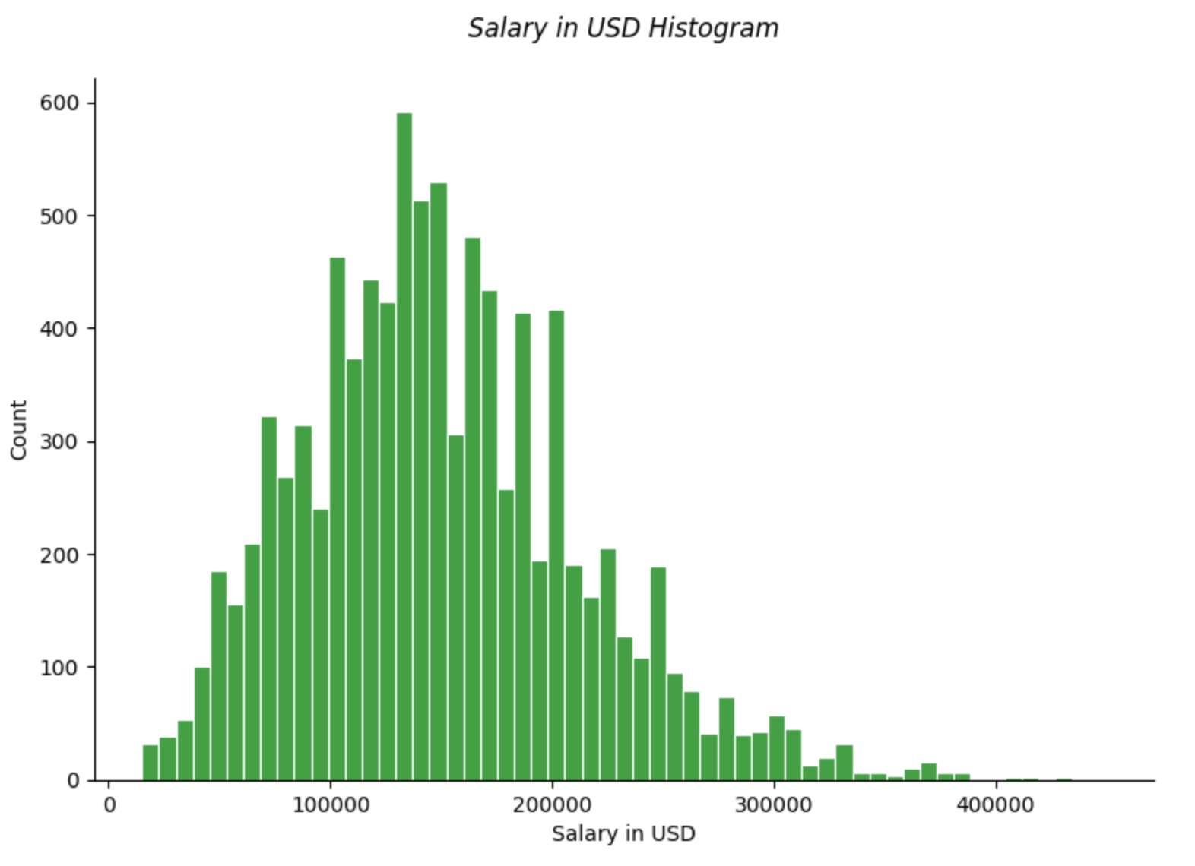
Bottom 10 Salaries Earned by Job Title, Experience Level and Location
The bottom 10 Salaries distribution shows the presence of possible outliers in the Data as seen in the Salary Distribution plot.

Slide 12
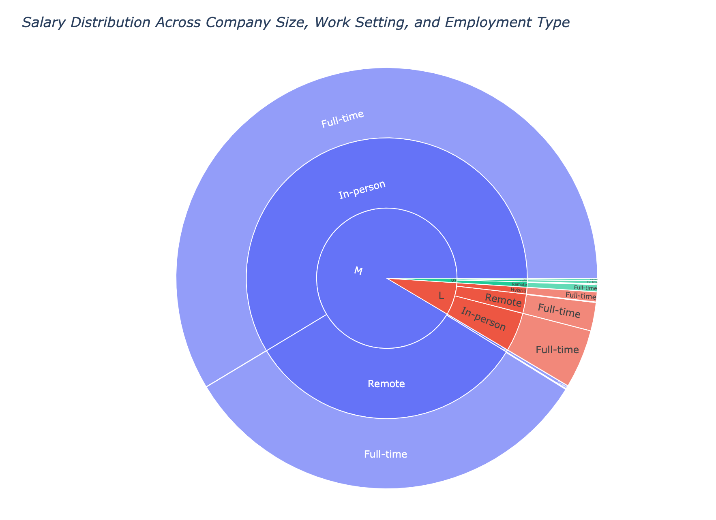
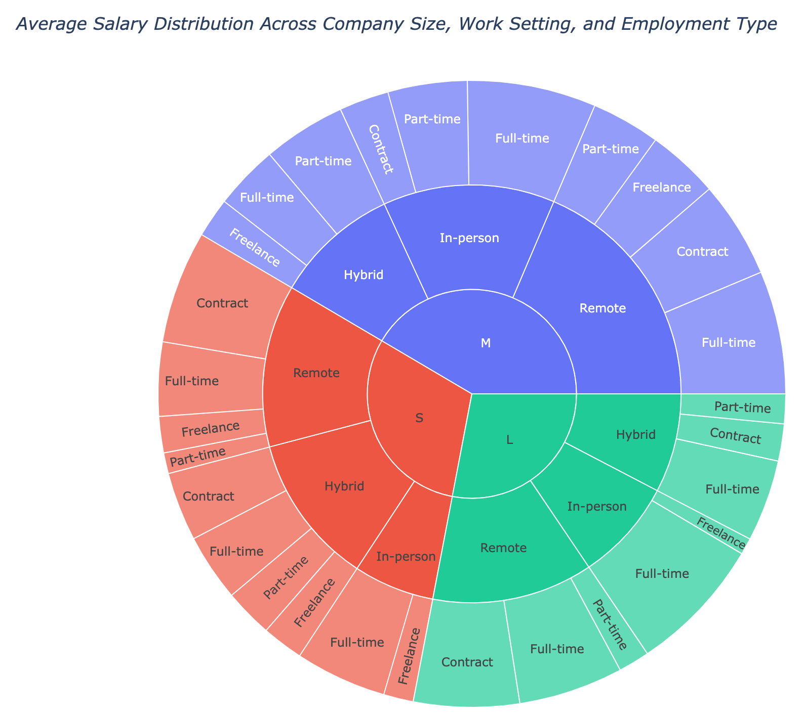
Distribution of Count and Average Salary Across Company Size, Work Setting and Employment Type
Count across Company Size, Work Setting and Employment Type shows a dominance of Medium Size companies working In-person and Full-Time. However, the Count does not Impact the Average Salary Earned except for Freelance and Part-time Worker as may be expected.

Slide 13

CONCLUSION
The data sector has witnessed exponential growth in job opportunities from 2020 to 2023, with a corresponding increase in average salaries, reflecting a robust and expanding market.
Data Science and Research, Data Engineering, and Data Analysis emerge as the most prevalent job categories, indicating key areas of demand and specialization within the field.
Despite its significance, Data Analysis ranks among the lower-paying categories, suggesting a potential discrepancy between job prominence and remuneration.
Senior-level roles dominate the job market, with salary increments aligned with rising experience levels, underscoring the value of expertise and career progression.
Geographical analysis reveals that the highest salaries are concentrated in North and South America and Europe, with notable exceptions like Qatar, highlighting regional disparities in compensation.
Company insights point to a predominance of medium-sized companies offering full-time, in-person roles, yet company size and work setting show minimal impact on salary levels, except in freelance and part-time positions.

